Slide 1
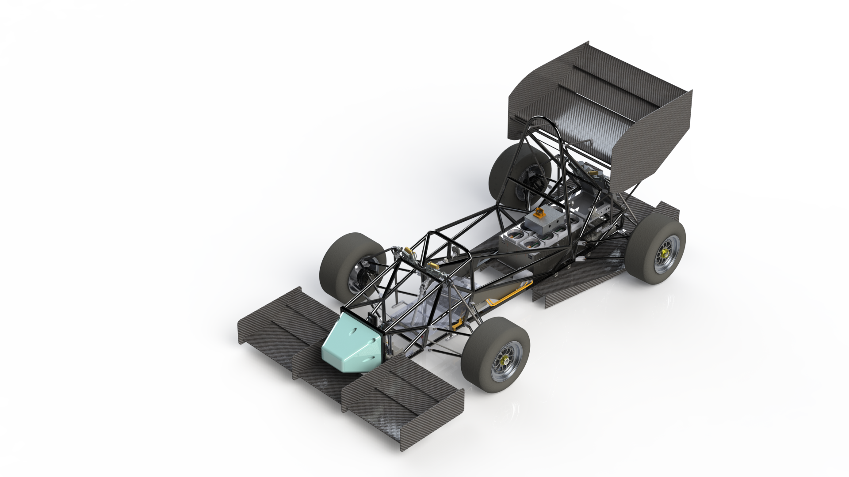
Torque Vectoring Overview
Purdue Electric Racing ‘22 Controls System

Slide 2
Desired Meeting Outcomes
Conceptual validation of torque vectoring model
Objective statement
Boundary Conditions
Yaw Control
Mathematical validation of torque vectoring model
Reference Yaw
Upper & Lower torque boundaries
Torque to Force conversion

Slide 3
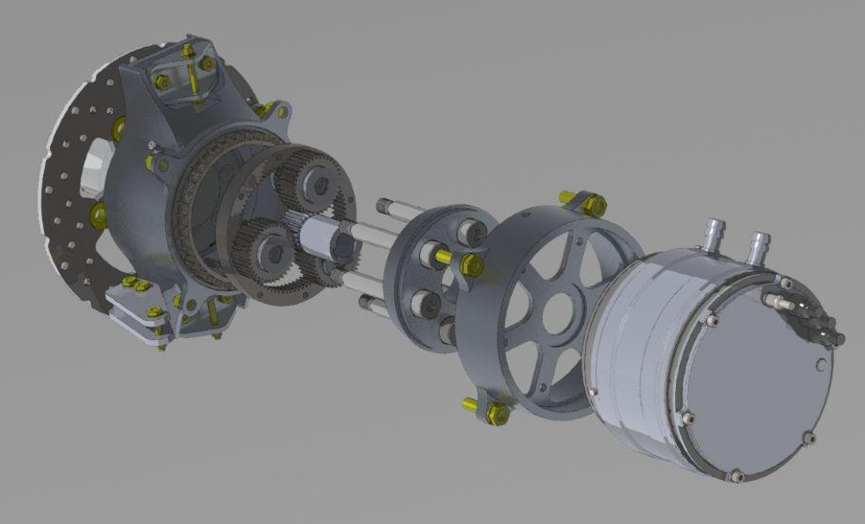
Motivation
To develop a control scheme for a 4WD hub motor system in Matlab/Simulink to be validated and implemented on PER ‘22.

Slide 4
Development
Research
Forze Hydrogen Racing 4WD torque vectoring model (Anton Stoop)
Race Car Vehicle Dynamics (Milliken & Milliken)
Matlab + Simulink vehicle body control schemes (Matlab documentation)

Slide 5
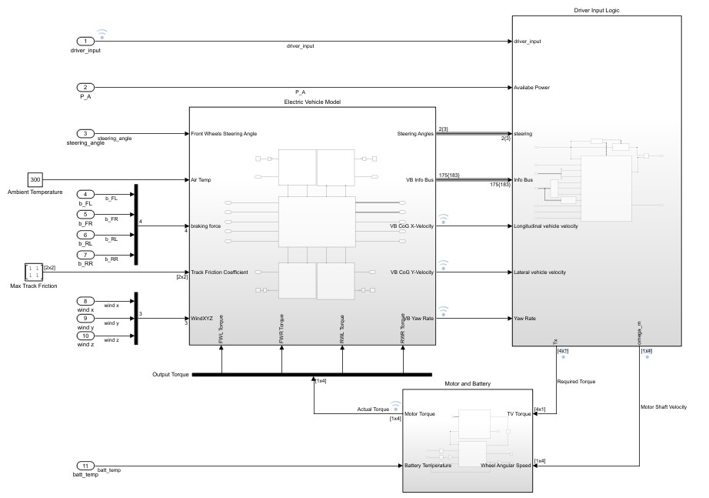
Development - Lap Sim Validation

Slide 6
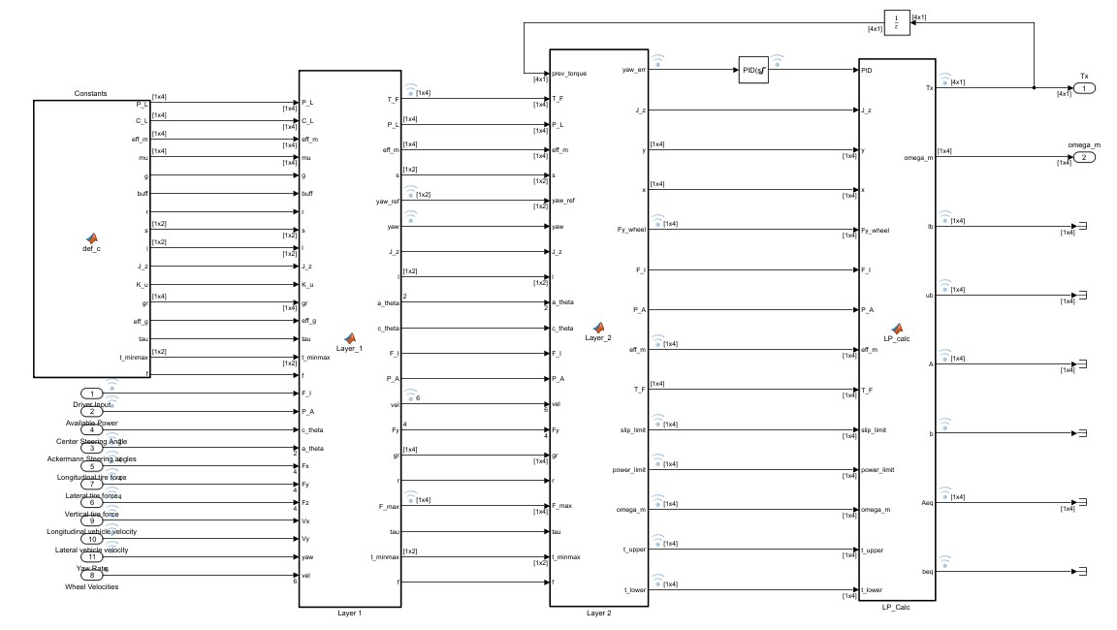
Development - Block Diagram

Slide 7
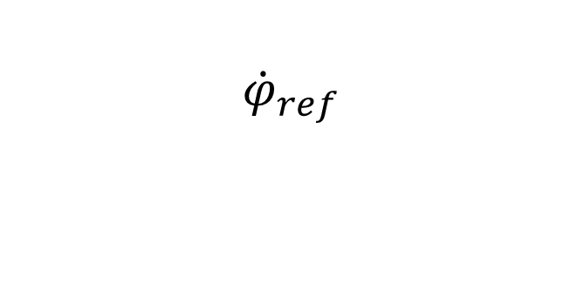


Development - PID
PI Controller, with fixed proportional and integral gains
Controls the yaw rate based on reference,
Error:
Output: Yaw moment,

Slide 8
Development - Upper & Lower Boundaries
Slip Boundary:
Torque must be less than the corresponding maximum longitudinal force on the ideal traction circle
Power Boundary:
Per motor power input must not exceed power input limit (15kW)
Motor Boundary:
Per motor torque request must not exceed the maximum and minimum torque each motor can achieve by the next time step

Slide 9
Development - Optimization Statement
Objective:
Maximize total driving force
Subject to:
Total power input must not exceed total power available
Moment about vehicle CG must be equal to PID
Torque per motor must stay between an upper and lower bounds, based on slip, power, and motor defined limits.
Pause:
Driving force as the objective
Lateral Forces influencing yaw acceleration
Constraining torque output
Multiple different optimization statements
Weights matrix for upper and lower boundaries

Slide 10
Project Difficulties
Determining friction limits of tires
Detect if slip does occur, how to react
Tire charactierization
Make system resilient against input error

Slide 11
Thanks to GM:
Tamim Noor
Ehsan Asadi
Patrick Monsere
Thanks to PER members:
Demetrius Gulewicz David Farrell Adam Busch Wasif Islam Tao Sun Zach Ellis Ruhaan Joshi Dawson Moore Jacob Kosiba James Hofstadler Ethan Brown

Slide 12
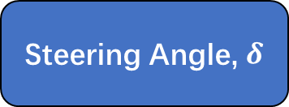
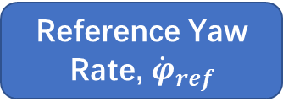
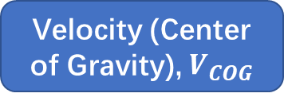
Development: Generating Reference Yaw Rate
Ideal Yaw Rate
Radius of Motion, R
Max Yaw Rate

Slide 13
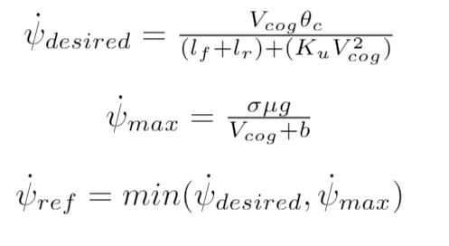
Development - Generate Reference Yaw
Desired yaw rate is a function of driver input steering angle.
Maximum yaw rate is limited by tire road friction coefficient. Simplified to exclude sideslip angle, a contribution factor is used to account for that simplification

Slide 14
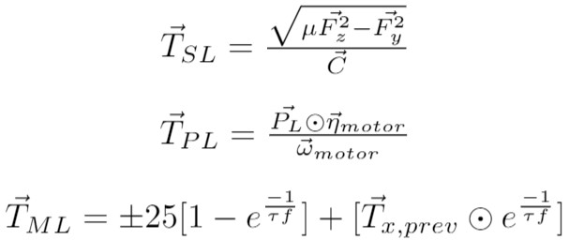
Development - Upper & Lower Boundaries
Torque must be less than the corresponding maximum longitudinal force on the current ideal traction circle
Per motor power input must not exceed power input limit (15kW)
Per motor torque request must not exceed the maximum and minimum torque each motor can achieve in the next time step

Slide 15
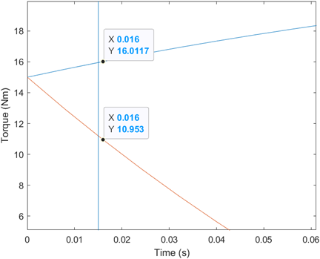

Development - Motor Boundaries
Per motor torque request must not exceed the maximum and minimum torque each motor can achieve in the next time step

Slide 16

Development - Torque to Force
Moment equation uses force at tires
Controller output is torque request for each wheel
Need to link motor shaft torque to driving force

Slide 17
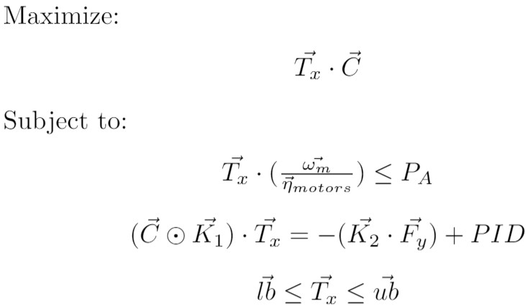
Development - Optimization Statement
Maximize total driving force
Total power input must not exceed total power available
Moment about vehicle CG must be equal to PID
Torque per motor must stay between an upper and lower bounds, based on slip, power, and motor defined limits.

Slide 18
Basic Results

